Slide 1
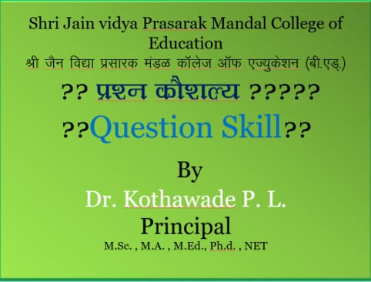

Slide 2
Background of Question Skill

Slide 3
Importance & Need Of Question skill

Slide 5
Elements of Question Presentation & Level of Question

Slide 6
fuEu Lrjh; iz”u
Close Question

Slide 7
Nature of Close Question

Slide 8
Open Question

Slide 10
Examples of Open Question
Is drowery syetem right ?
What title will you suggest for Paragraph?
How is India?
How can we this page better?
How does this Topic connect to the topic we were discussed in the Last week’s lesson ?

