Slide 1
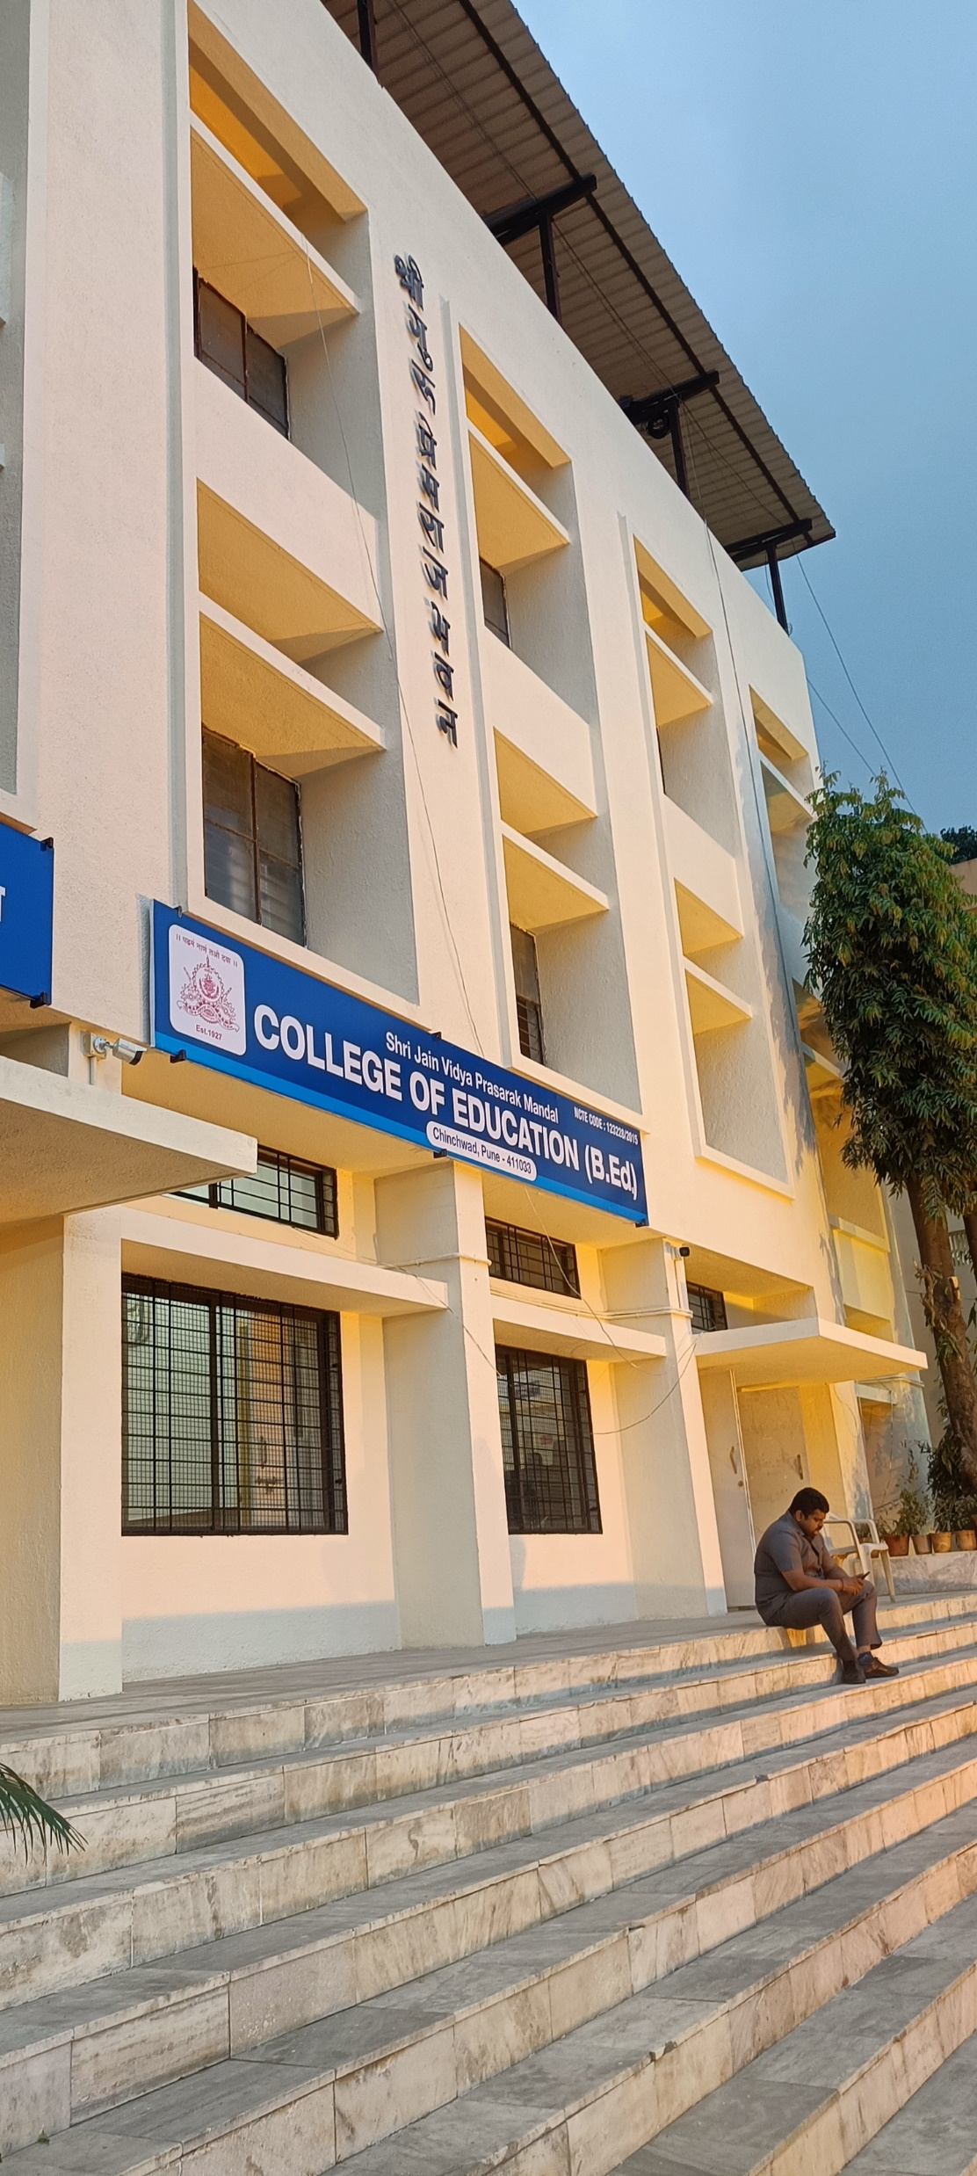
Shri Jain vidya Prasarak Mandal College of Education
Course No.-101 Childhood & GrowingUp
Chapter No.- 1 Topic – Adolescence Stage
PPT Presentation
Dr. Kothawade P. L.
M.Sc., M.A. , M.Ed. Ph.d. NET

